Slide 1
Probabilistic Programming
Marius Popescu
popescunmarius@gmail.com
2018 - 2019

Slide 2
PyMC Framework
PyMC is a python module that implements Bayesian statistical models and fitting algorithms

Slide 3
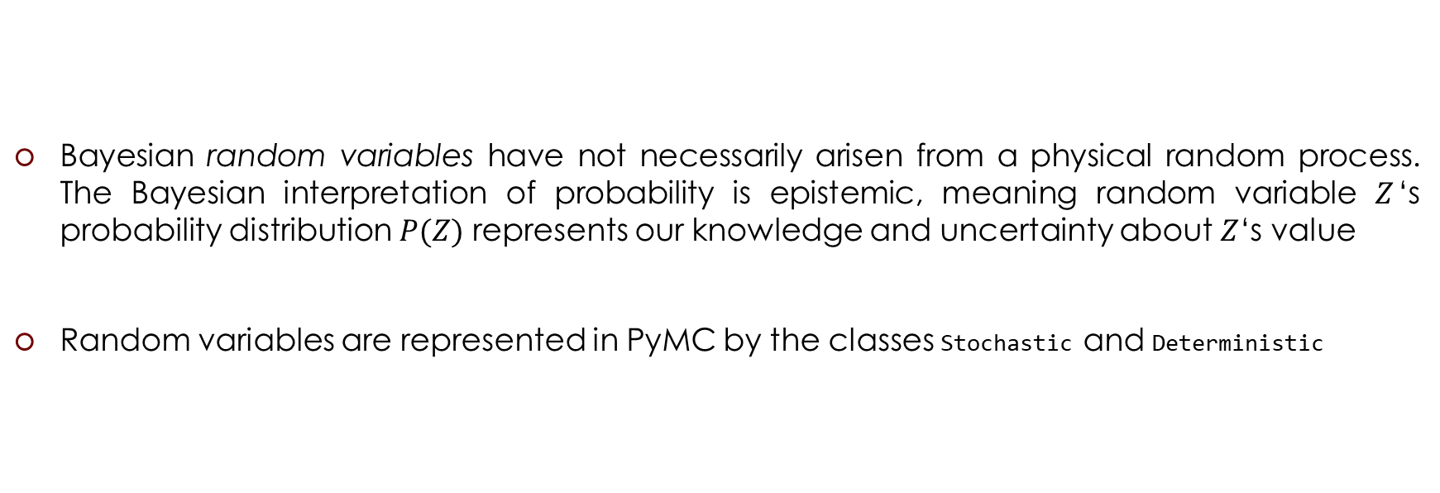
Two Types of Variables
Bayesian random variables have not necessarily arisen from a physical random process. The Bayesian interpretation of probability is epistemic, meaning random variable $Z$‘s probability distribution $P(Z)$ represents our knowledge and uncertainty about $Z$‘s value
Random variables are represented in PyMC by the classes Stochastic and Deterministic

Slide 4
Parent and Child Relationships
Parent variables are variables that influence another variable
Child variables are variables that are affected by other variables, i.e. are the subject of parent variables
A variable can be both a parent and child
a child can have more than one parent, and a parent can have many children
import pymc as pm
parameter = pm.Exponential("poisson_param", 1)
data_generator = pm.Poisson("data_generator", parameter)
data_plus_one = data_generator + 1
parameter is a parent of data_generator
data_generator is a child of parameter
data_generator is a parent of data_plus_one
data_plus_one is a child of data_generator

Slide 5
Parent and Child Relationships
A variable's children and parent variables can be accessed using the children and parents attributes attached to variables:
print("Children of `parameter`: "); print(parameter.children)
print("\nParents of `data_generator`: "); print(data_generator.parents)
print("\nChildren of `data_generator`: "); print(data_generator.children)
[Output]:
Children of `parameter`:
{<pymc.distributions.new_dist_class.<locals>.new_class 'data_generator' at 0x7f812404a8d0>}
Parents of `data_generator`:
{'mu': <pymc.distributions.new_dist_class.<locals>.new_class 'poisson_param' at 0x7f812404a898>}
Children of `data_generator`:
{<pymc.PyMCObjects.Deterministic '(data_generator_add_1)' at 0x7f812404a908>}

Slide 6
Parent and Child Relationships
PyMC variables have the following additional attributes:
extended_parents:
A set containing all the stochastic variables on which the variable depends either directly or via a sequence of deterministic variables. If the value of any of these variables changes, the variable will need to recompute its log-probability.
extended_children:
A set containing all the stochastic variables and potentials that depend on the variable either directly or via a sequence of deterministic variables. If the variable’s value changes, all of these variables will need to recompute their log-probabilities.

Slide 7
PyMC Variables
All PyMC variables have an attribute called value that stores the current (possibly random) internal value of that variable:
print("parameter.value =", parameter.value)
print("data_generator.value =", data_generator.value)
print("data_plus_one.value =", data_plus_one.value)
[Output]:
parameter.value = 0.032177775515776275
data_generator.value = 0
data_plus_one.value = 1

Slide 8
PyMC Stochastic Variables

Slide 9
PyMC Stochastic Variables
A stochastic variable can optionally be endowed with a method called random, which draws a value for the variable given the values of its parents:
Z = pm.DiscreteUniform("Z", lower = 1, upper = 6)
print(Z.value)
Z.random(); print(Z.value)
Z.random(); print(Z.value)
[Output]:
4
6
2

Slide 10
PyMC Stochastic Variables
The logarithm of a stochastic object’s probability mass or density can be accessed via the logp attribute:
Z = pm.DiscreteUniform("Z", lower = 1, upper = 6); print(Z.logp, np.log(1./6.))
X = pm.Exponential("X", np.e, value=[1], observed=True); print(X.logp, 1-np.e)
X = pm.Exponential("X", np.e, value=[0], observed=True); print(X.logp)
[Output]:
-1.791759469228055 -1.791759469228055
-1.718281828459045 -1.718281828459045
1.0

Slide 11
PyMC Stochastic Variables
Stochastic objects have the following additional attributes:
observed:
A flag (boolean) indicating whether the variable’s value has been observed (is fixed).
dtype:
A NumPy dtype object (such as numpy.int) that specifies the type of the variable’s value to fitting methods. If this is None (default) then no type is enforced.

Slide 12
Creation of Stochastic Variables
There are three main ways to create stochastic variables, called the automatic, decorator, and direct interfaces

Slide 13
Creation of Stochastic Variables Automatic
Stochastic variables with standard distributions provided by PyMC

Slide 14
PyMC provides a large suite of built-in probability distributions
For each distribution, it provides:
A function that evaluates its log-probability or log-density: normal_like()
A function that draws random variables: rnormal()
A function that computes the expectation associated with the distribution: normal_expval()
A Stochastic subclass generated from the distribution: Normal

Slide 15
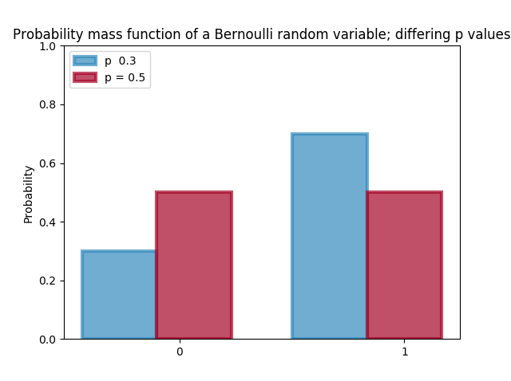

Bernoulli Distribution
$$Z\sim \text{Ber}(p)$$
$$P\left(Z=k\right)=p^{k}{(1−p)}^{1−k}, k=0,1$$
$$E\left(Z | p\right)=\sum_{k=0}^{1}{kP(Z=k)}=p$$
Z = pymc.Bernoulli(“Z”, p)

Slide 16
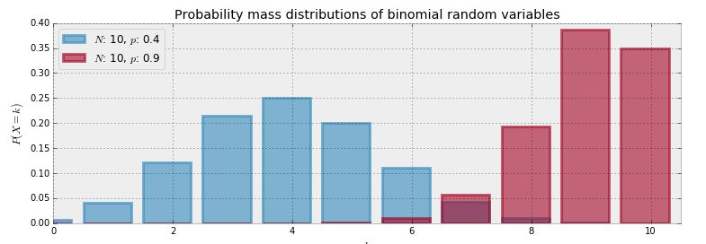
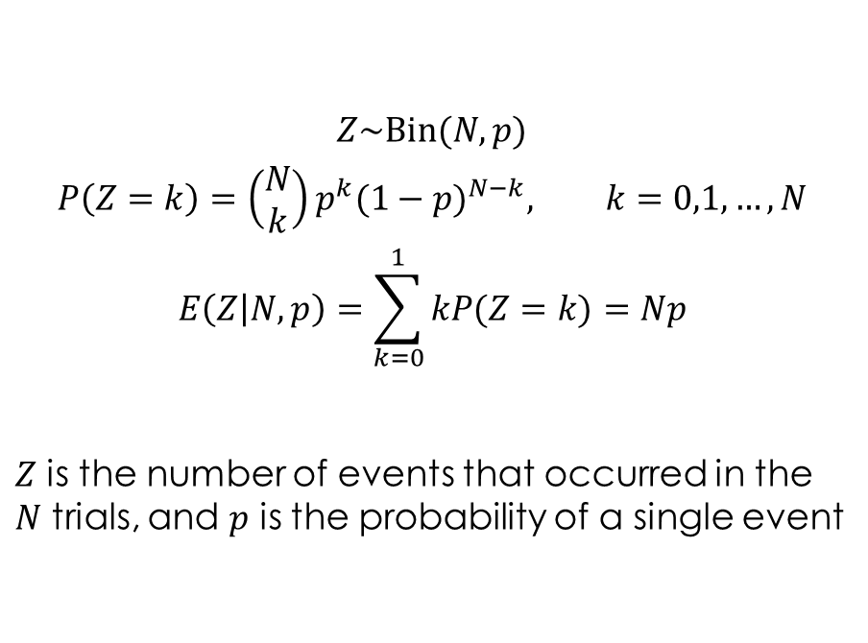
Binomial Distribution
$$Z\sim \text{Bin}(N,p)$$
$$P\left(Z=k\right)={\left(\begin{aligned}N \\ k\end{aligned}\right)p}^{k}{(1−p)}^{N−k}, k=0,1, …, N$$
$$E\left(Z | N,p\right)=\sum_{k=0}^{1}{kP(Z=k)}=Np$$
$Z$ is the number of events that occurred in the $N$ trials, and $p$ is the probability of a single event
Z = pymc.Binomial(“Z”, N, p)

Slide 17
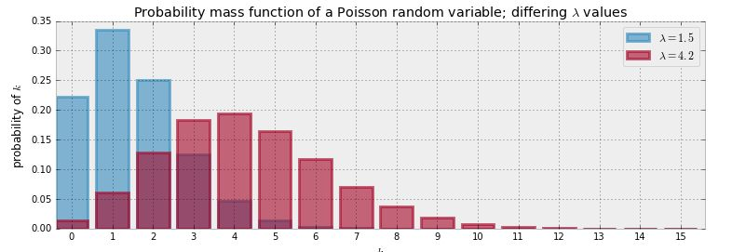
Poisson Distribution
$$Z\sim \text{Poi}(λ)$$
$$P\left(Z=k\right)=\frac{λ^{k}e^{−λ}}{k!}, k=0,1,2,…, λ∈ℝ_{>0}$$
$$E\left(Z | λ\right)=\sum_{k=0}^{∞}{kP(Z=k)}= λ$$
Z=pymc.Poisson(“Z”, lambda_)

Slide 18
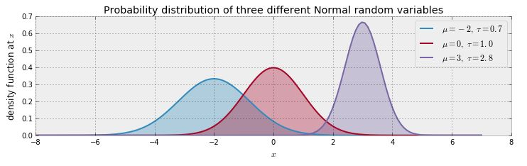
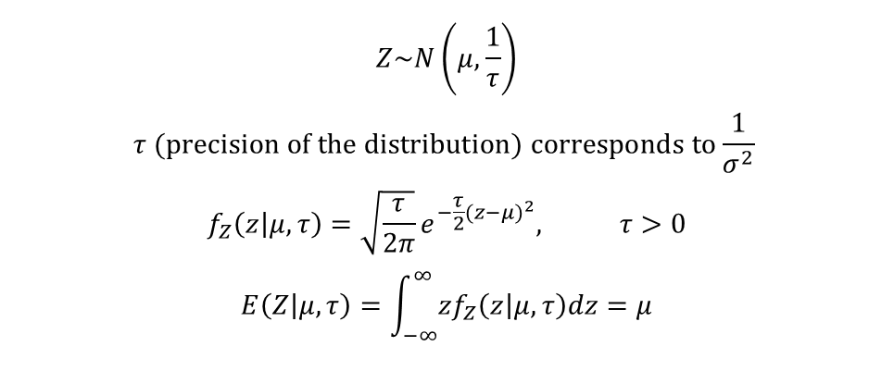
Normal Distribution
$$Z\sim N\left(μ, \frac{1}{τ}\right)$$
$$τ \text{(}\text{precision} \text{of} \text{the} \text{distribution}\text{)} \text{corresponds} \text{to}\frac{1}{σ^{2}}$$
$$f_{Z}\left(z | μ,τ\right)=\sqrt{\frac{τ}{2π}}e^{−\frac{τ}{2}{(z−μ)}^{2}}, τ>0$$
$$E\left(Z | μ,τ\right)=\int_{−∞}^{∞}{zf_{Z}\left(z | μ,τ\right)dz}=μ$$
Z=pymc.Normal(“Z”, mu, tau)

Slide 19
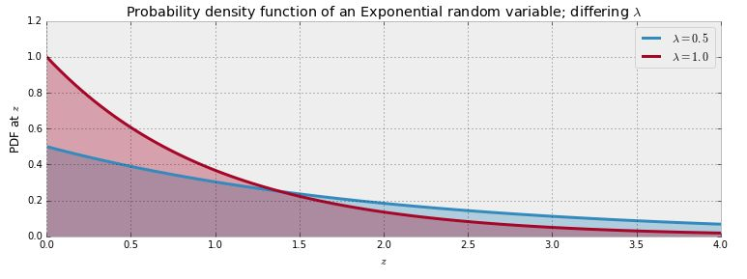
Exponential Distribution
$$Z\sim \text{Exp}(λ)$$
$$f_{Z}\left(z | λ\right)=λe^{−λz}, z≥0$$
$$E\left(Z | λ\right)=\int_{−∞}^{∞}{zf_{Z}\left(z | λ\right)dz}=\frac{1}{λ}$$
Z=pymc.Exponential(“Z”, lambda_)

Slide 20
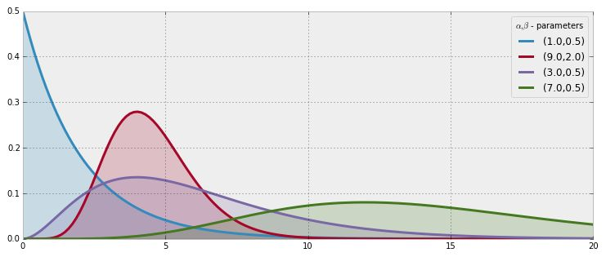
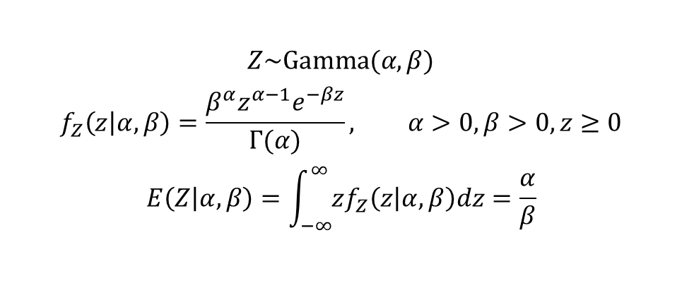
Gamma Distribution
$$Z\sim \text{Gamma}(α,β)$$
$$f_{Z}\left(z | α,β\right)=\frac{β^{α}z^{α−1}e^{−βz}}{Γ(α)}, α>0, β>0, z≥0$$
$$E\left(Z | α,β\right)=\int_{−∞}^{∞}{zf_{Z}\left(z | α,β\right)dz}=\frac{α}{β}$$
Z=pymc.Gamma(“Z”, alpha, beta)

Slide 21
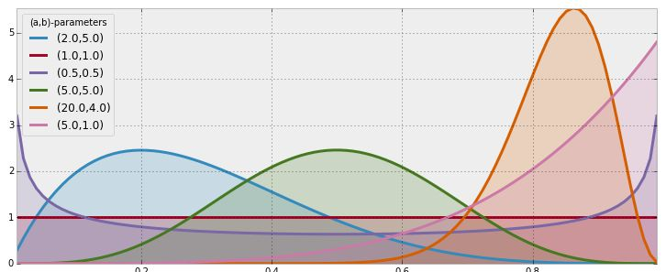
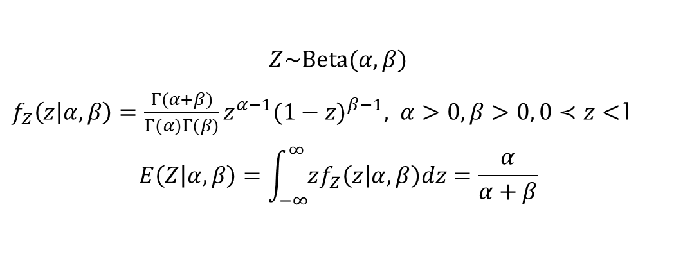
Beta Distribution
$$Z\sim \text{Beta}(α,β)$$
$f_{Z}\left(z | α,β\right)=\frac{Γ(α+β)}{Γ(α)Γ(β)}z^{α−1}{(1−z)}^{β−1}, α>0, β>0, 0≺z<$1
$$E\left(Z | α,β\right)=\int_{−∞}^{∞}{zf_{Z}\left(z | α,β\right)dz}=\frac{α}{α+β}$$
Z=pymc.Beta(“Z”, alpha, beta)

Slide 22
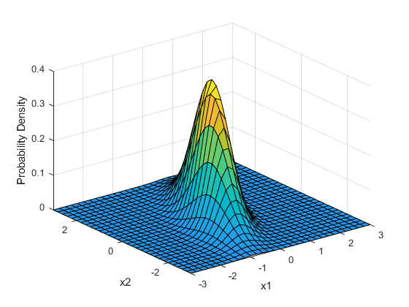
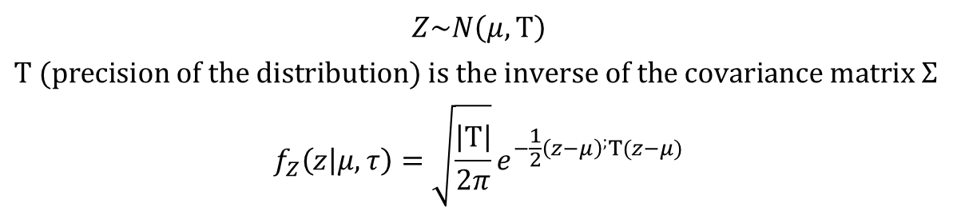
Multivariate Normal Distribution
$$Z\sim N\left(μ, Τ\right)$$
$$Τ \text{(}\text{precision} \text{of} \text{the} \text{distribution}\text{) }\text{is} \text{the} \text{inverse} \text{of} \text{the} \text{covariance} \text{matrix} Σ$$
$$f_{Z}\left(z | μ,τ\right)=\sqrt{\frac{\left|Τ\right|}{2π}}e^{−\frac{1}{2}{\left(z−μ\right)}^{;}Τ(z−μ)}$$
Z = pm.MvNormal("Z", np.array([2.,4., 6.]), np.identity(3))
Z.random(); print(Z.value)
[Output]:
[ 2.66051582 4.46602181 6.6511556 ]

Slide 23
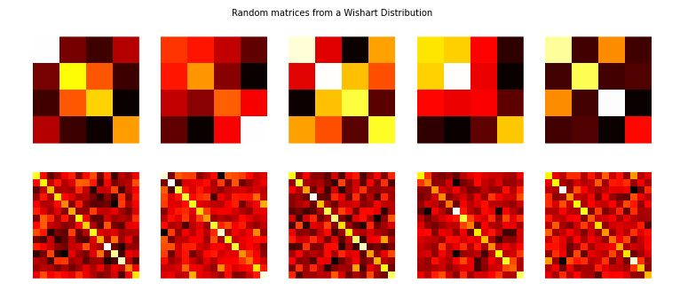
Wishart Distribution
Wishart distribution is a distribution over all positive semi-definite matrices
Covariance matrices are positive-definite, hence the Wishart is an appropriate prior for covariance matrices

Slide 24
There Are More
https://pymc-devs.github.io/pymc/distributions.html

Slide 25
Creation of Stochastic Variables Stochastic Decorator

Slide 26
@pymc.stochastic
A python function preceded by @pymc.stochastic decorator will create a pymc.Stochastic object, which takes its name from the function it decorates, and has all the familiar methods and attributes
The Stochastic object produced by the @stochastic decorator will evaluate its log-probability using the function. The value argument, which is required, provides an initial value for the variable. The remaining arguments will be assigned as parents
The value and parents of stochastic variables may be any objects, provided the log-probability function returns a real number (float)
The decorator stochastic can take any of the arguments Stochastic.__init__ takes except parents, logp, random, doc and value. These arguments include trace, plot, verbose, dtype, rseed and name
The decorator interface allows to specify a random method for sampling the stochastic variable’s value conditional on its parents

Slide 27
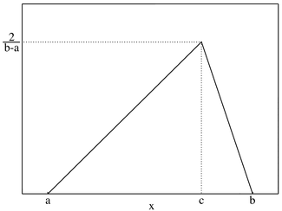
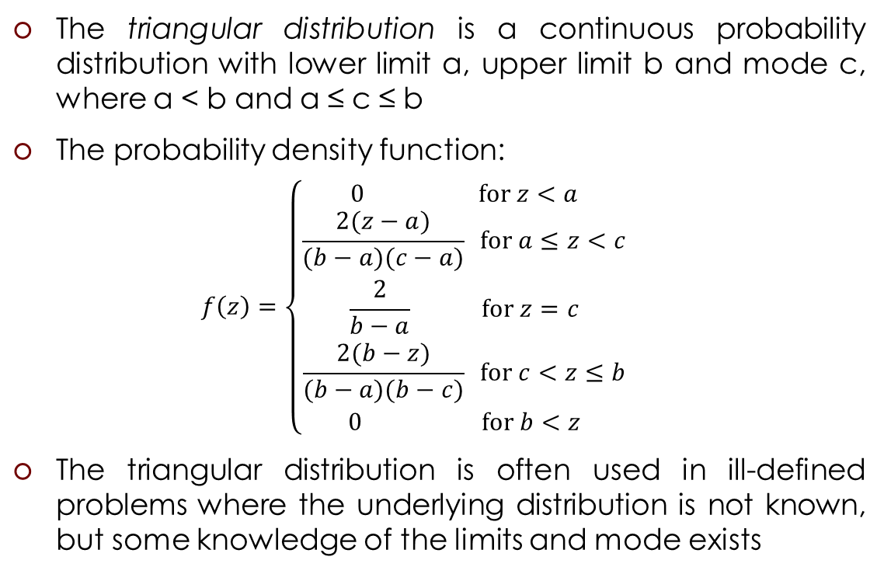
Example: Triangular Distribution
The triangular distribution is a continuous probability distribution with lower limit a, upper limit b and mode c, where a < b and a ≤ c ≤ b
The probability density function:
$$f\left(z\right)=\left\{\begin{aligned}0 \text{for} z<a \\ \frac{2(z−a)}{(b−a)(c−a)} \text{for} a≤z<c \\ \frac{2}{b−a} \text{for} z=c \\ \frac{2(b−z)}{(b−a)(b−c)} \text{for} c<z≤b \\ 0 \text{for} b<z\end{aligned}\right.$$
The triangular distribution is often used in ill-defined problems where the underlying distribution is not known, but some knowledge of the limits and mode exists

Slide 28
Example: Triangular Distribution
@pm.stochastic(dtype=float)
def Z(value = c, a = a, b = b, c = c):
def logp(value, a, b, c):
if a <= value < c:
return np.log((2. * (value - a)) / ((b - a) * (c - a)))
if value == c:
return np.log(2. / (b - a))
if c < value <= b:
return np.log((2. * (b - value)) / ((b - a) * (b - c)))
return -np.inf
def random(a, b, c):
return np.random.triangular(a, c, b)

Slide 29
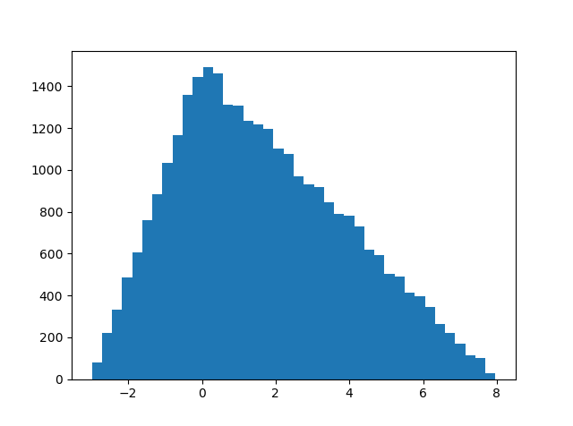
Example: Triangular Distribution
a = -3
b = 8
c = 0
.......................
model = pm.Model([Z])
mcmc = pm.MCMC(model)
mcmc.sample(40000, 10000, 1)
Z_samples = mcmc.trace('Z')[:]
plt.hist(Z_samples, bins = 40)
plt.show()

Slide 30
Creation of Stochastic Variables Direct

Slide 31
It’s possible to instantiate pymc.Stochastic directly
def triangular_logp(value, a, b, c):
if a <= value < c:
return np.log((2. * (value - a)) / ((b - a) * (c - a)))
if value == c:
return np.log(2. / (b - a))
if c < value <= b:
return np.log((2. * (b - value)) / ((b - a) * (b - c)))
return -np.inf
def triangular_random(a, b, c):
return np.random.triangular(a, c, b)
Z = pm.Stochastic( logp = triangular_logp,
doc = 'Triangular Distribution',
name = 'Z',
parents = {'a': -3, 'b': 8, 'c': 0},
random = triangular_random,
trace = True,
value = 0,
dtype = float,
rseed = 1.,
observed = False,
cache_depth = 2,
plot=True,
verbose = 0)

Slide 32
A Warning: Don’t update stochastic variables’ values in-place
Stochastic objects’ values should not be updated in-place. This confuses PyMC’s caching scheme and corrupts the process used for accepting or rejecting proposed values in the MCMC algorithm
The only way a stochastic variable’s value should be updated is using statements of the following form:
A.value = new_value
The following are in-place updates and should never be used:
A.value += 3
A.value[2] = 5

Slide 33
PyMC Deterministic Variables

Slide 34
The Deterministic Class
The Deterministic class represents variables whose values are completely determined by the values of their parents
A deterministic variable’s most important attribute is value, this attribute is computed on-demand and cached for efficiency
Deterministic variables have no methods

Slide 35
Creation of Deterministic Variables
There are three main ways to create deterministic variables, called the automatic, decorator, and direct interfaces

Slide 36
Creation of Deterministic Variables Automatic
A handful of common functions have been wrapped in Deterministic objects

Slide 37
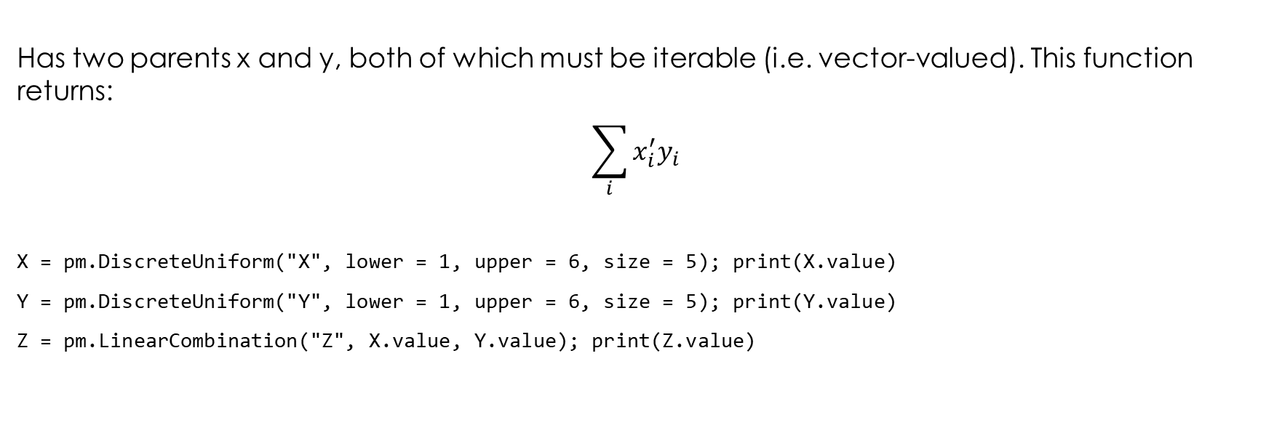
LinearCombination
Has two parents x and y, both of which must be iterable (i.e. vector-valued). This function returns:
$$\sum_{i}{x_{i}^{′}y_{i}}$$
X = pm.DiscreteUniform("X", lower = 1, upper = 6, size = 5); print(X.value)
Y = pm.DiscreteUniform("Y", lower = 1, upper = 6, size = 5); print(Y.value)
Z = pm.LinearCombination("Z", X.value, Y.value); print(Z.value)

Slide 38
Index
Has two parents x and index. x must be iterables, index must be valued as an integer
X = pm.DiscreteUniform("X", lower = 1, upper = 6, size = 5); print(X.value)
Y = pm.DiscreteUniform("Y", lower = 0, upper = 5); print(Y.value)
Z = pm.Index("Z", X.value, Y.value); print(Z.value)
Index is useful for implementing dynamic models, in which the parent-child connections change

Slide 39
Lambda
Converts an anonymous function (in Python, called lambda functions) to a Deterministic instance on a single line
beta = pm.Normal("coefficients", 0, size=(N, 1))
x = np.random.randn((N, 1))
linear_combination = pm.Lambda(lambda x=x, beta=beta: np.dot(x.T, beta))

Slide 40

CompletedDirichlet:
PyMC represents Dirichlet variables of length k by the first k−1 elements; since they must sum to 1, the $k^{th}$ element is determined by the others. CompletedDirichlet appends the $k^{th}$ element to the value of its parent D

Slide 41
Logit, InvLogit, StukelLogit, StukelInvLogit
Common link functions for generalized linear models, and their inverses

Slide 42
Elementary Operations on Variables
elementary operations, like addition, exponentials etc. implicitly create deterministic variables
>>> x = pymc.MvNormalCov('x',np.ones(3),np.eye(3))
>>> y = pymc.MvNormalCov('y',np.ones(3),np.eye(3))
>>> print x+y
<pymc.PyMCObjects.Deterministic '(x_add_y)' at 0x105c3bd10>
>>> print x[0]
<pymc.CommonDeterministics.Index 'x[0]' at 0x105c52390>
>>> print x[1]+y[2]
<pymc.PyMCObjects.Deterministic '(x[1]_add_y[2])' at 0x105c52410>
All the objects thus created have trace=False and plot=False by default

Slide 43
Creation of Deterministic Variables Deterministic Decorator

Slide 44
@pymc.deterministic
@pm.deterministic
def some_deterministic_var(v1=v1,):
#jelly goes here.
For all purposes, we can treat the object some_deterministic_var as a variable and not a Python function
Notice that rather than returning the log-probability, as is the case for Stochastic objects, the function returns the value of the deterministic object, given its parents

Slide 45
Creation of Deterministic Variables Direct

Slide 46
Deterministic objects can also be instantiated directly
def lambda_eval(tau=tau, lambda_1=lambda_1, lambda_2=lambda_2):
out = np.zeros(n_count_data)
out[:tau] = lambda_1 # lambda before tau is lambda1
out[tau:] = lambda_2 # lambda after (and including) tau is lambda2
return out
Lambda_ = pymc.Deterministic(eval = lamnda_eval,
name = ‘lambda_',
parents = {‘tau’: tau, ‘lambda_1’: lambda_1, ‘lambda_2': lambda_2},
doc = 'The lambda before and after tau',
trace = True,
verbose = 0,
dtype=float,
plot=False,
cache_depth = 2)

Slide 47
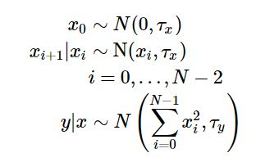
Containers
In some situations it would be inconvenient to assign a unique label to each parent of some variable. Consider y in the following model:
Here, $y$ depends on every element of the Markov chain x, but we wouldn’t want to manually enter N parent labels 'x_0', 'x_1', etc.

Slide 48
Containers
This situation can be handled naturally in PyMC:
N = 10
x_0 = pymc.Normal('x_0', mu=0, tau=1)
x = np.empty(N, dtype=object)
x[0] = x_0
for i in range(1, N):
x[i] = pymc.Normal('x_%i' % i, mu=x[i-1], tau=1)
@pymc.observed
def y(value=1, mu=x, tau=100):
return pymc.normal_like(value, np.sum(mu**2), tau)

Slide 49
Containers
Containers, like variables, have an attribute called value. This attribute returns a copy of the iterable that was passed into the container function, but with each variable inside replaced with its corresponding value
Containers can be constructed from lists, tuples, dictionaries, Numpy arrays, modules, sets or any object with a __dict__ attribute
Containers have the following useful attributes in addition to value:
variables
stochastics
potentials
deterministics
data_stochastics
step_methods
Each of these attributes is a set containing all the objects of each type in a container, and within any containers in the container.

Slide 50
Not covered yet
The Potential class
The Model class
objects that fit models: MCM, MAP, NormApprox
The Sampler class: Metropolis, AdaptativeMetropolis, DiscreteMetropolis, BinaryMetropolis, Slicer, Gibbs

Slide 51
Example: Cheating among students

Slide 52
Privacy Algorithm
In the interview process for each student, the student flips a coin, hidden from the interviewer. The student agrees to answer honestly if the coin comes up heads. Otherwise, if the coin comes up tails, the student (secretly) flips the coin again, and answers "Yes, I did cheat" if the coin flip lands heads, and "No, I did not cheat", if the coin flip lands tails. This way, the interviewer does not know if a "Yes" was the result of a guilty plea, or a Heads on a second coin toss. Thus privacy is preserved and the researchers receive honest answers.
Warner, S. L. (March 1965). "Randomised response: a survey technique for eliminating evasive answer bias". Journal of the American Statistical Association.

Slide 53

Using PyMC to dig through this noisy model
Suppose 100 students are being surveyed for cheating, and we wish to find $p$, the proportion of cheaters
Since we are quite ignorant about $p$, we will assign it a Uniform(0,1) prior
N = 100
p = pm.Uniform("freq_cheating", 0, 1)

Slide 54
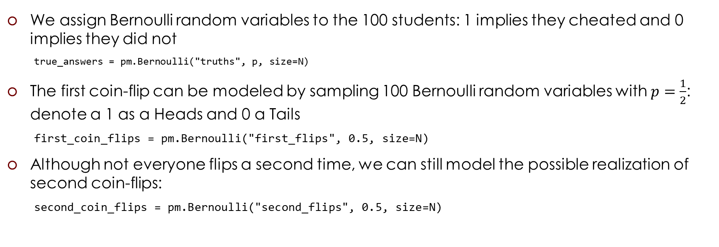
Using PyMC to dig through this noisy model
We assign Bernoulli random variables to the 100 students: 1 implies they cheated and 0 implies they did not
true_answers = pm.Bernoulli("truths", p, size=N)
The first coin-flip can be modeled by sampling 100 Bernoulli random variables with $p=\frac{1}{2}$: denote a 1 as a Heads and 0 a Tails
first_coin_flips = pm.Bernoulli("first_flips", 0.5, size=N)
Although not everyone flips a second time, we can still model the possible realization of second coin-flips:
second_coin_flips = pm.Bernoulli("second_flips", 0.5, size=N)

Slide 55
Using PyMC to dig through this noisy model
Using previous variables, we can return a possible realization of the observed proportion of "Yes" responses
@pm.deterministic
def observed_proportion(t_a=true_answers, fc=first_coin_flips, sc=second_coin_flips):
observed = fc * t_a + (1 - fc) * sc
return observed.sum() / float(N)

Slide 56
Using PyMC to dig through this noisy model
Suppose that after performing our coin-flipped interviews the researchers received 35 "Yes" responses. The researchers observe a Binomial random variable, with N = 100 and p = observed_proportion with value = 35:
X = 35
observations = pm.Binomial("obs", N, observed_proportion, observed=True, value=X)

Slide 57
Using PyMC to dig through this noisy model
The model:
model = pm.Model([p, true_answers, first_coin_flips, second_coin_flips, observed_proportion, observations])
mcmc = pm.MCMC(model)
mcmc.sample(40000, 15000)
p_trace = mcmc.trace("freq_cheating")[:]

Slide 58
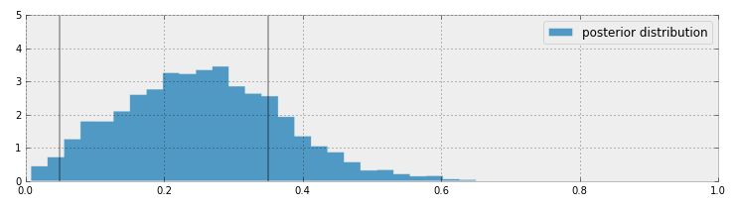
Posterior Distribution

Slide 59
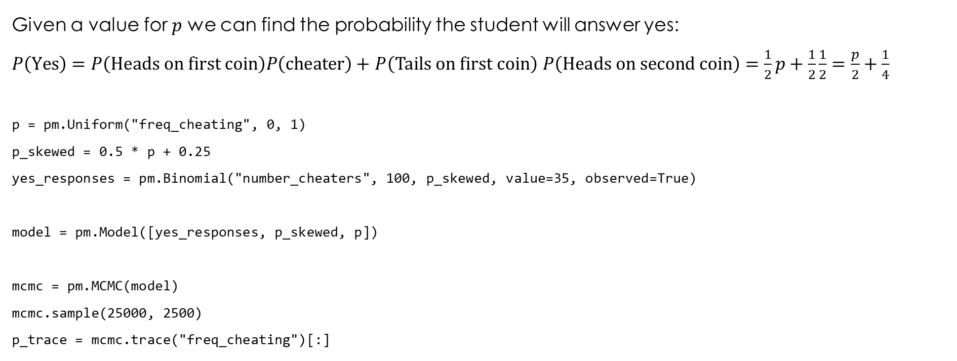
Alternative Simplified Model
Given a value for $p$ we can find the probability the student will answer yes:
$P\left(\text{Yes}\right)=P\left(\text{Heads} \text{on} \text{first} \text{coin}\right)P\left(\text{cheater}\right)+$ $P\left(\text{Tail}\text{s} \text{on} \text{first} \text{coin}\right)$ $P\left(\text{Heads} \text{on} \text{second} \text{coin}\right)=\frac{1}{2}p+\frac{1}{2}\frac{1}{2}=\frac{p}{2}+\frac{1}{4}$
p = pm.Uniform("freq_cheating", 0, 1)
p_skewed = 0.5 * p + 0.25
yes_responses = pm.Binomial("number_cheaters", 100, p_skewed, value=35, observed=True)
model = pm.Model([yes_responses, p_skewed, p])
mcmc = pm.MCMC(model)
mcmc.sample(25000, 2500)
p_trace = mcmc.trace("freq_cheating")[:]

Slide 60
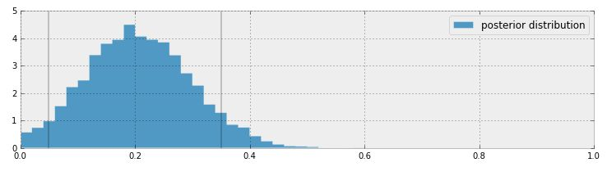
Posterior Distribution

